Slide 1


Eedi - Mining Misconceptions in Mathematics
Post-Competition Review
Speaker: Bobby Lee
Singapore 2025

Slide 2
Appendix
Introduction
Background
Dataset
Evaluation metrics
Algorithm (data filling, Fine-tuning LLM)
Retrieval
Rerank
Similarity Matching

Slide 3
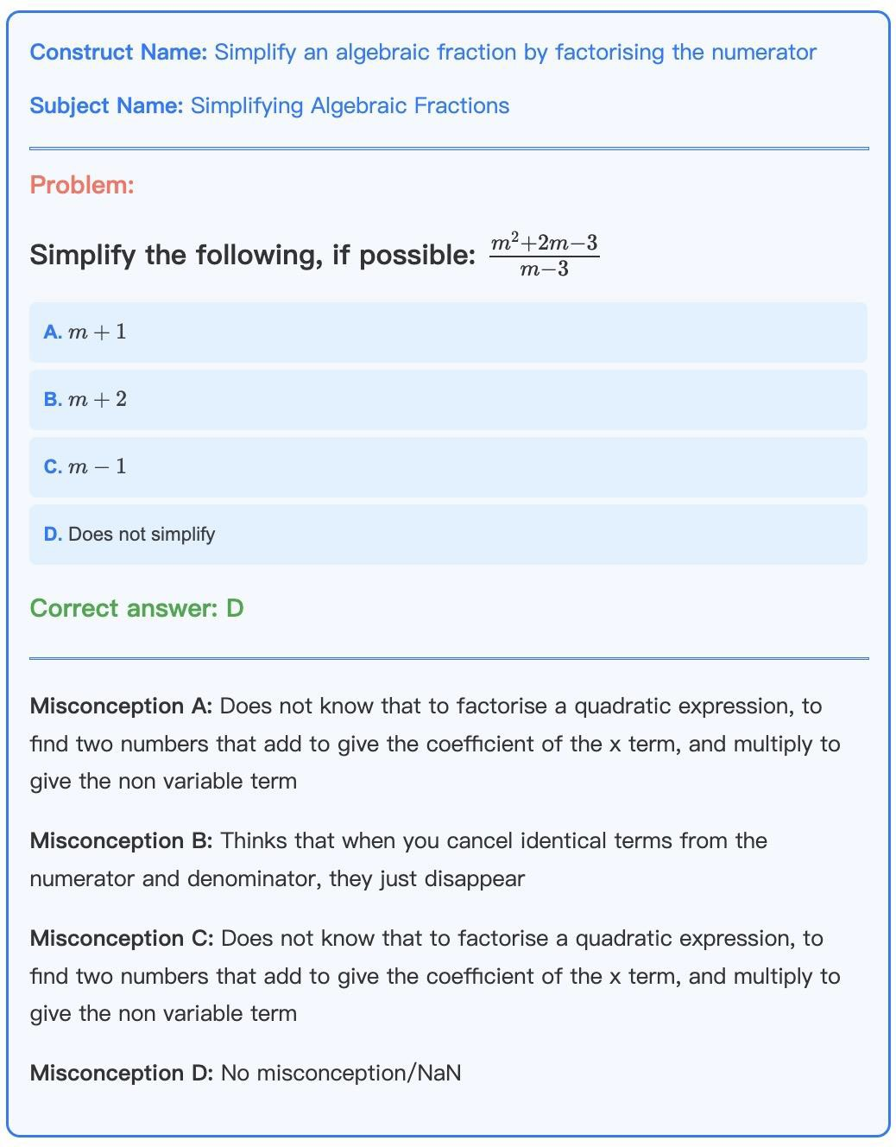
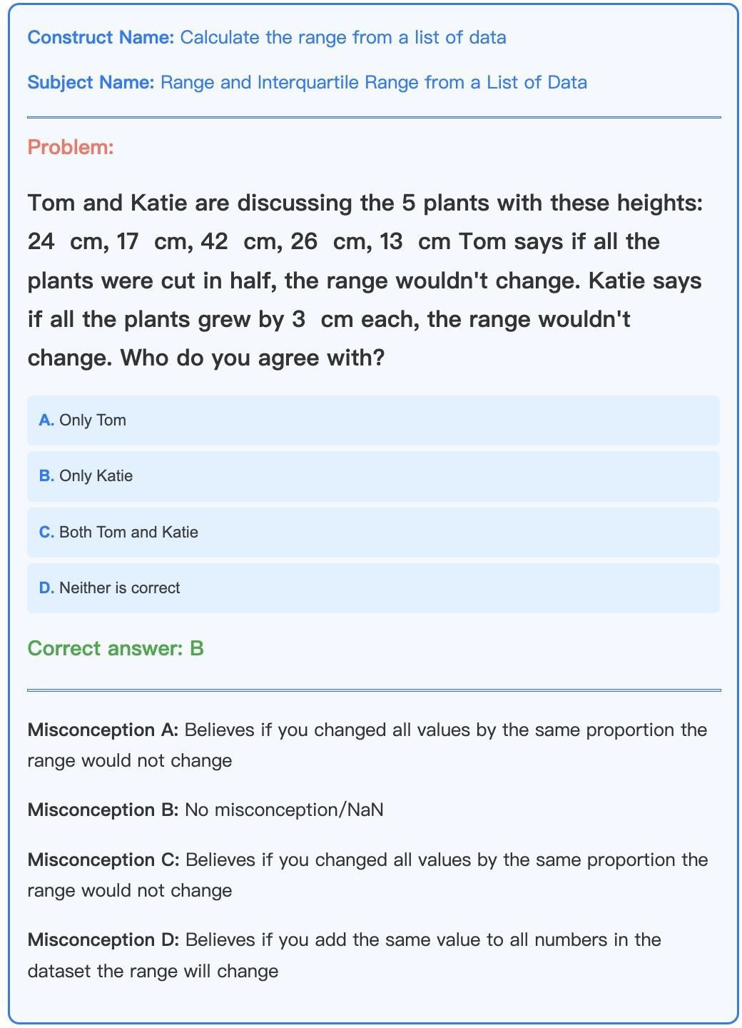
Introduction
This competition aims to predict the correlation between incorrect options (distractors) and potential misconceptions in multiple-choice math questions by building natural language processing (NLP) models. Traditionally, manual annotation requires each incorrect option to be carefully matched with corresponding misconceptions, a process that is time-consuming and prone to inconsistency. The competition challenges participants to develop models that can automate or semi-automate this matching process. These models should not only cover known misconceptions but also generalize well to newly emerging ones, thereby effectively reducing the burden of manual annotation and improving educational quality.

Slide 4
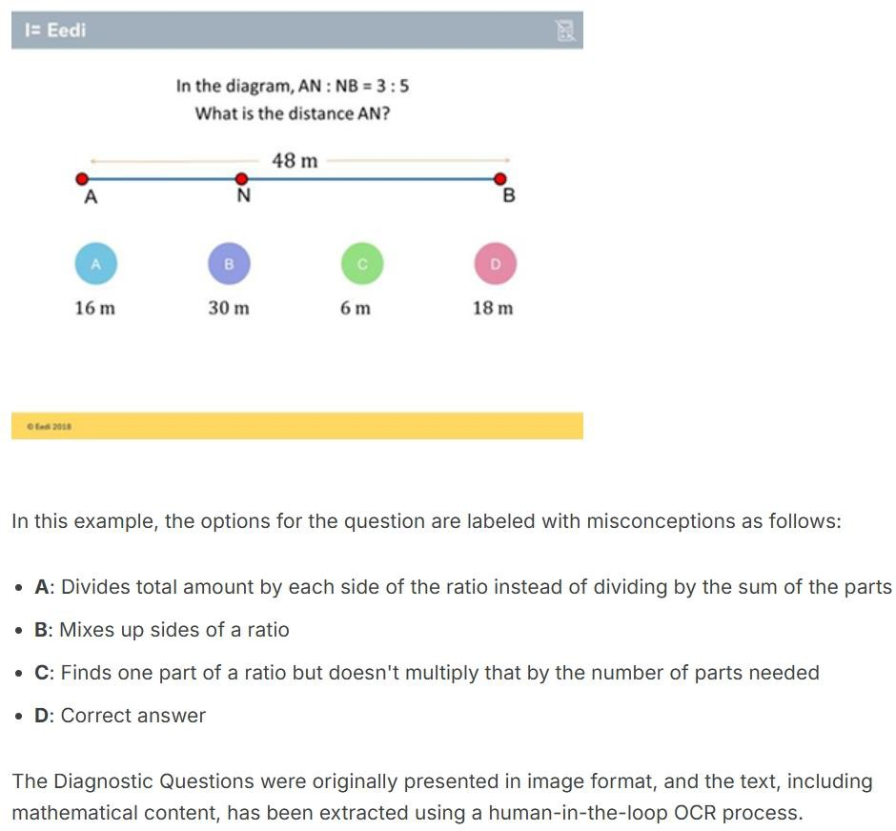
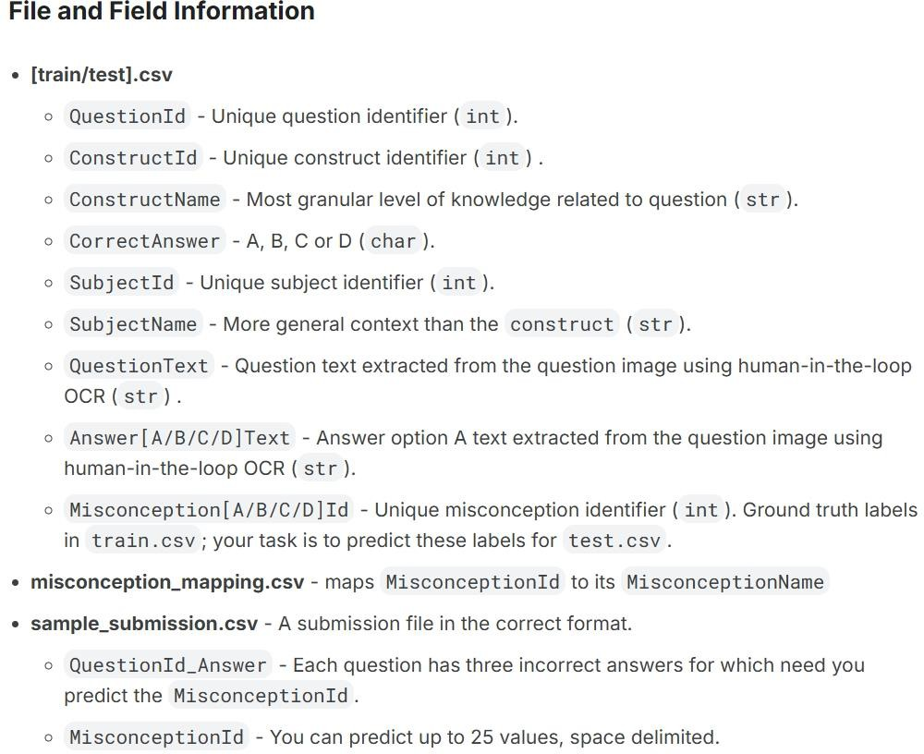
Background – Competition Data

Slide 5
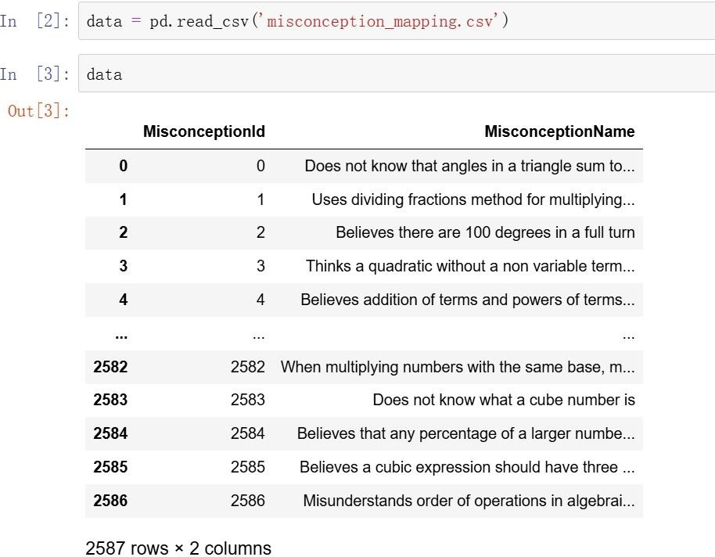
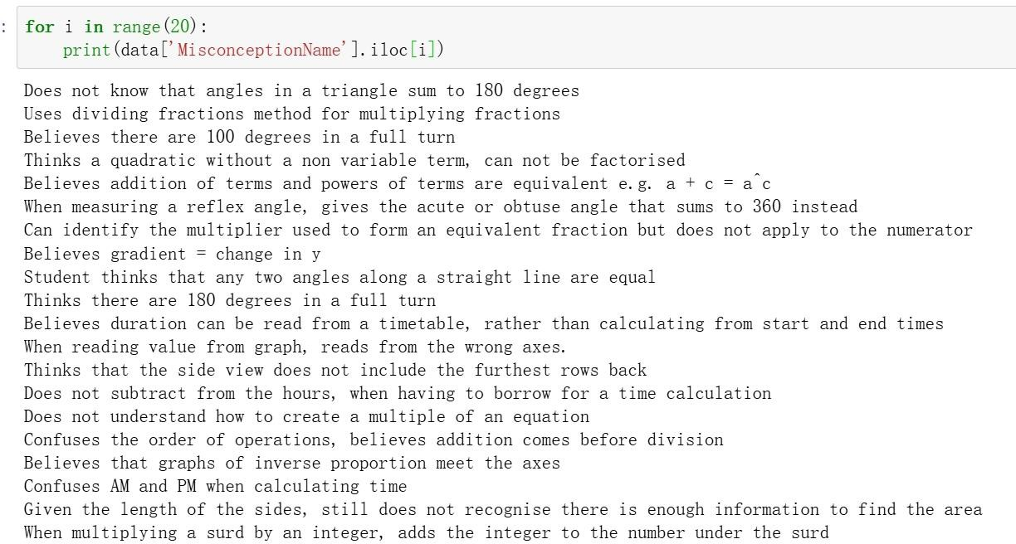
Dataset: misconception_mapping.csv Details of Misconception Matching with IDs

Slide 6
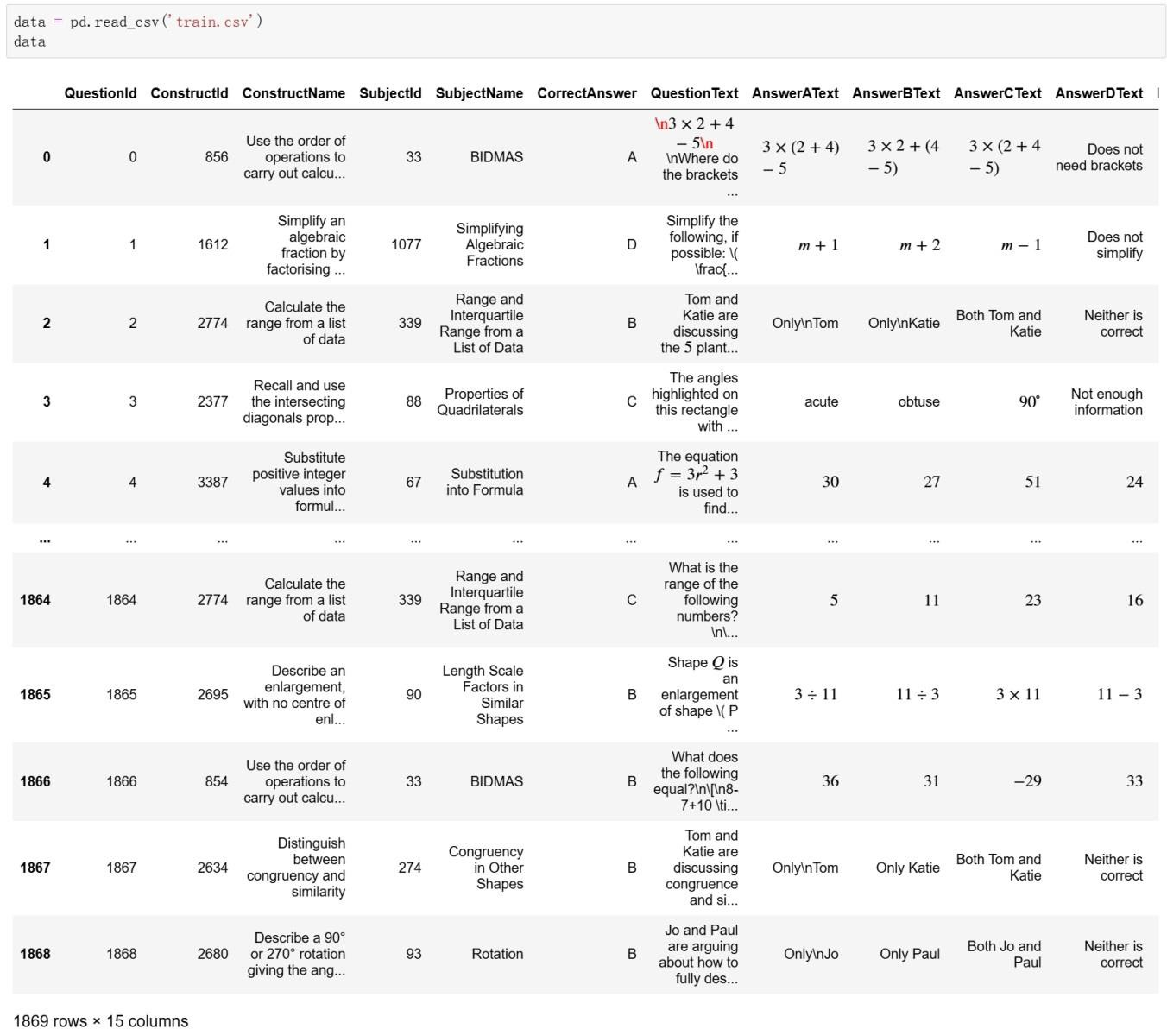
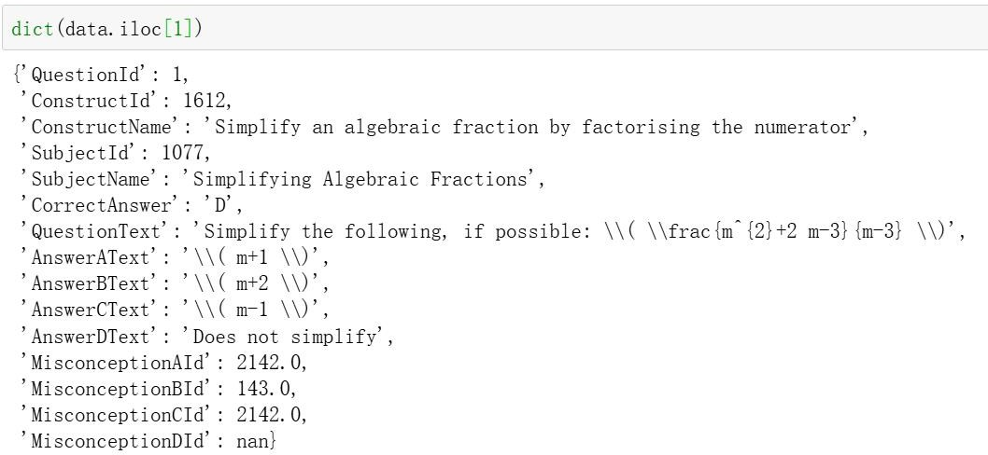
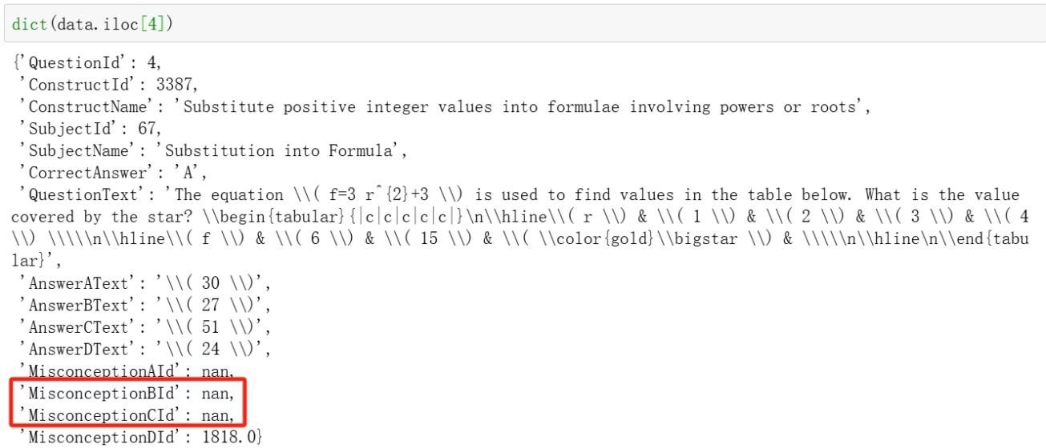
Dataset: train.csv

Slide 7
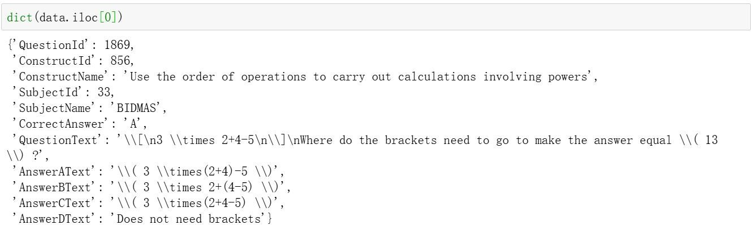
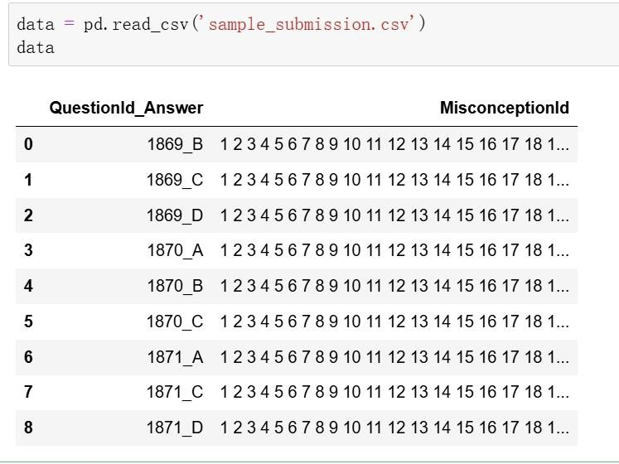
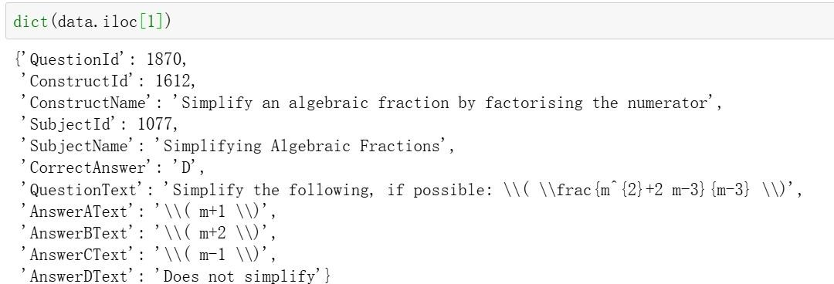
Dataset: test.csv / sample_submission.csv

Slide 8
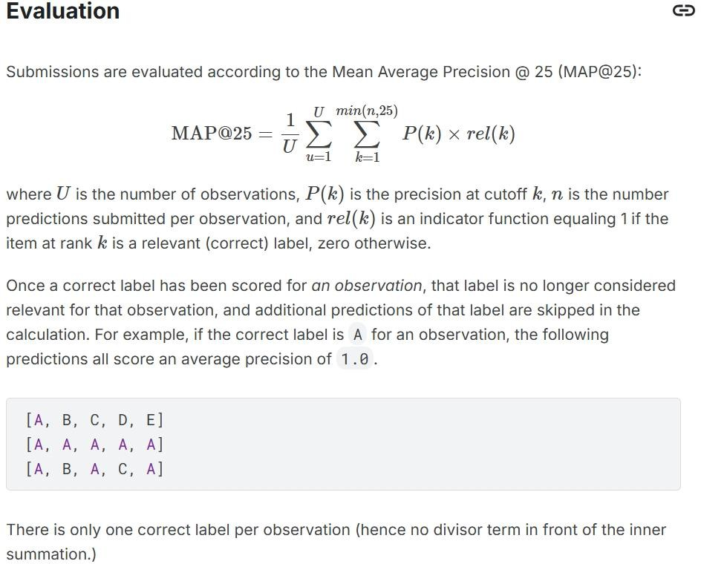
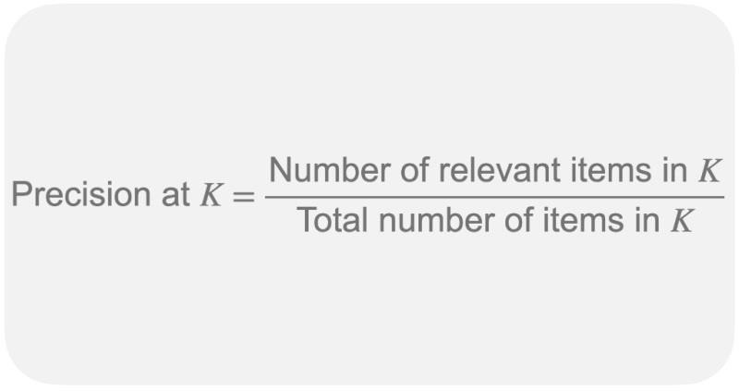
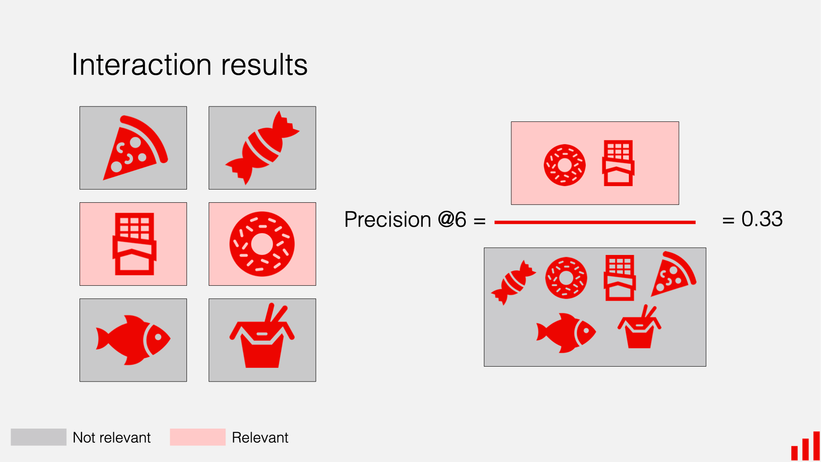
Evaluation Metrics

Slide 9
Algorithm
This competition utilises fine-tuning of Large Language Models (LLMs) to perform retrieval and re-ranking to identify misconceptions in math problems. The algorithm workflow is as follows:
Data Generation and Model Training: Initially, GPT-4o is employed to generate missing misconception data from the official dataset, constructing the sample information into training data. Based on the Qwen-14b-instruct and Qwen-32b-instruct large models, fine-tuning is conducted using contrastive learning. During this phase, a 4-bit quantised model version is used, with LoRA (Low-Rank Adaptation) techniques applied to train multiple linear modules.
Retrieval and Model Fusion: In the retrieval stage, embeddings from three LLMs with different training methods or varying parameters are concatenated, followed by similarity-based retrieval to shortlist candidates.
Re-ranking: The top 25 prediction results from the retrieval stage are re-ranked using Qwen-32b-instruct-AWQ. The re-ranking statements are input into Qwen-32b-instruct-AWQ, leveraging its zero-shot capability to output new ranking statements. The top 25 results are processed in batches; simultaneously, bge-large-en-v1.5 is used to search for the best results from a specified retrieval library based on similarity.

Slide 10
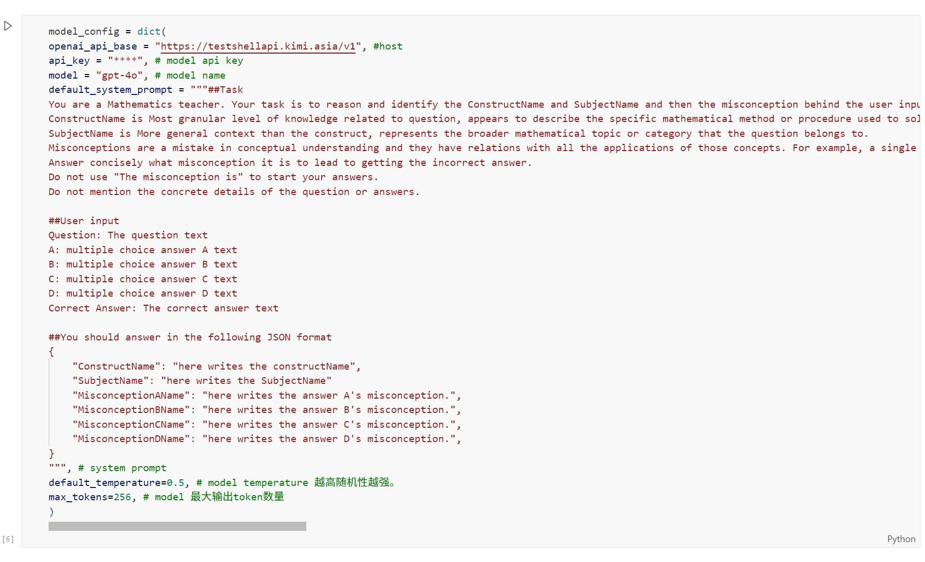
Data Generation: Filling Missing Misconceptions
Algorithm

Slide 11
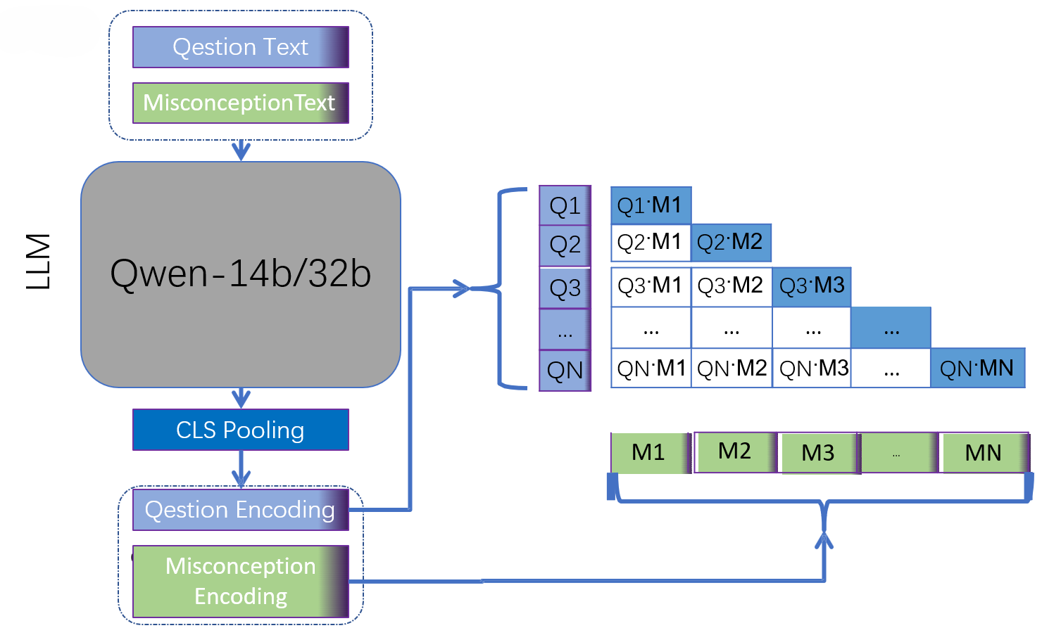
Contrastive Learning Fine-Tuning of LLM
Algorithm

Slide 12
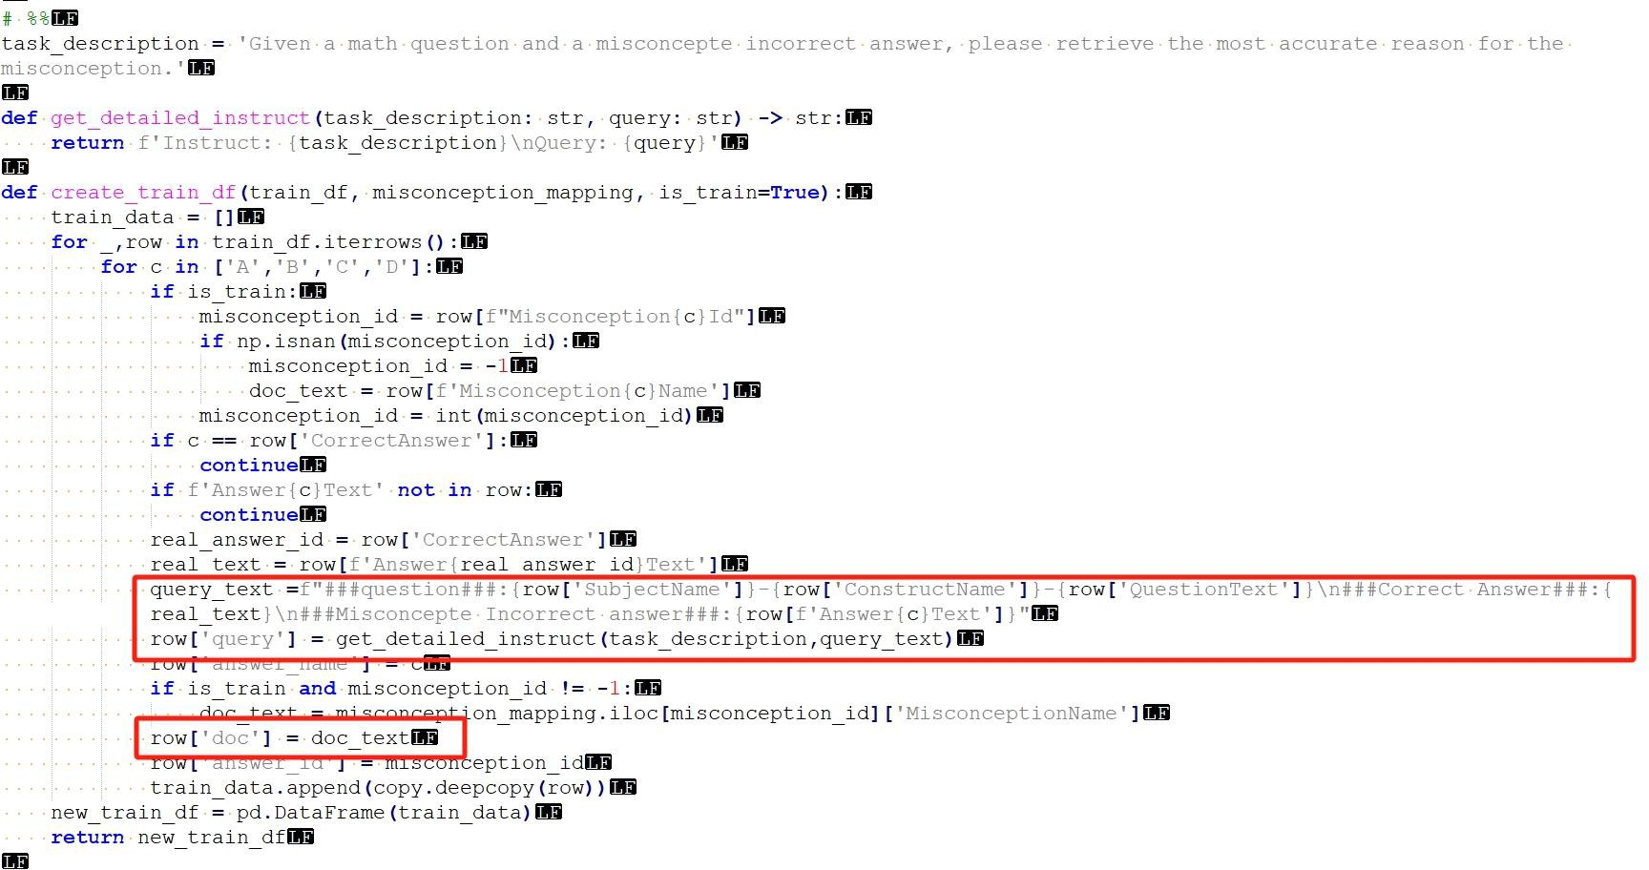
Algorithm

Slide 13
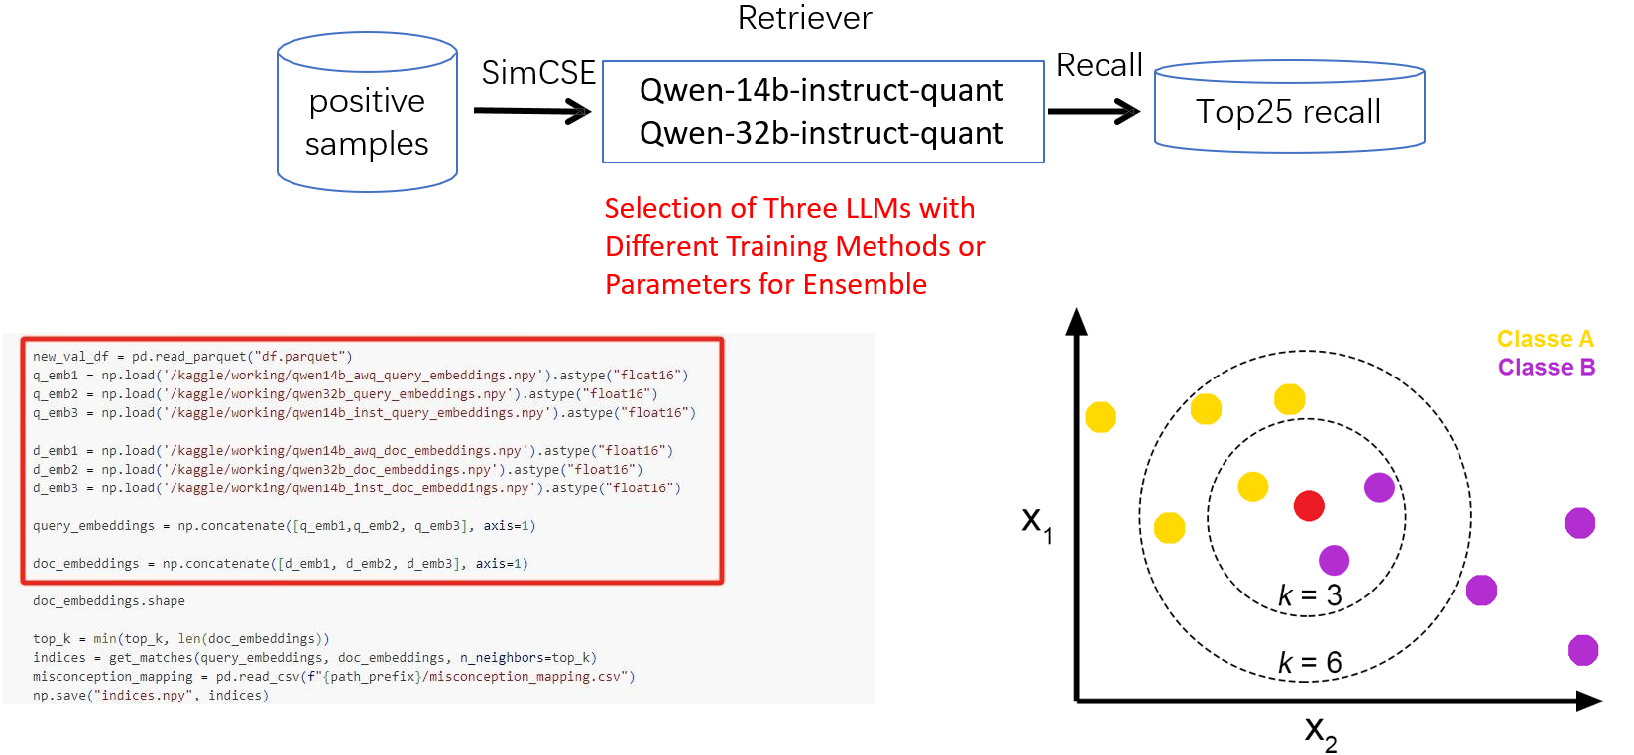
Retrieval

Slide 14
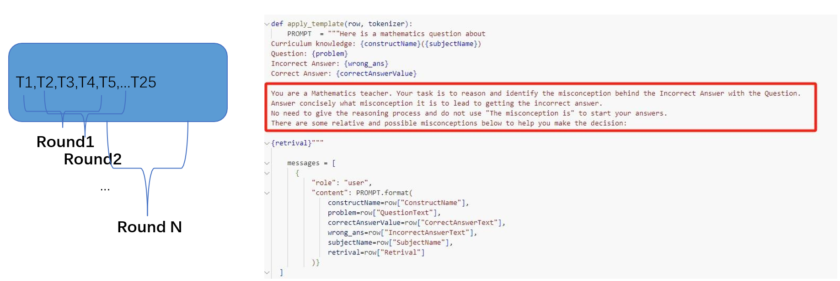
Rerank
KNN Algorithm Relies on Vector Distance for Result Ranking, Which Is Overly Coarse, Requiring a More Advanced Re-ranking Approach.

Slide 15
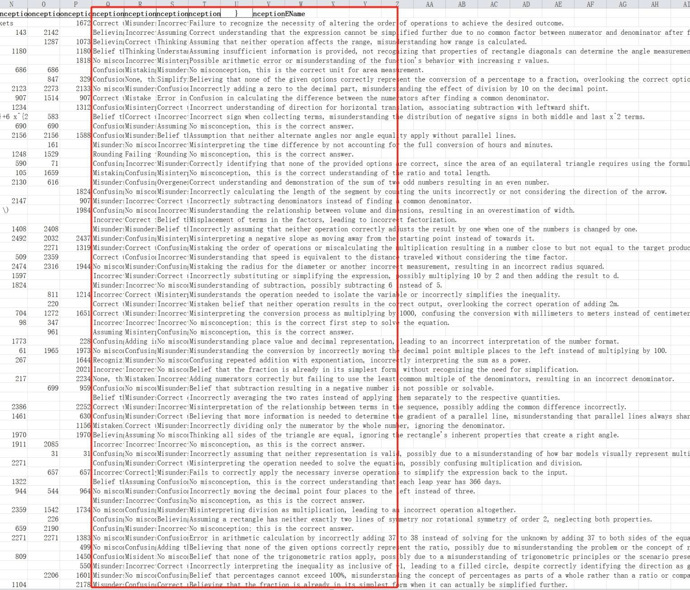
Similarity Matching
label: misconception_mapping.csv

Slide 16
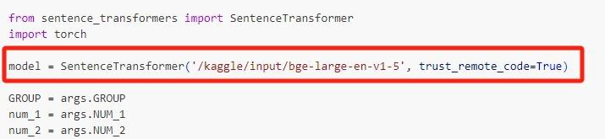
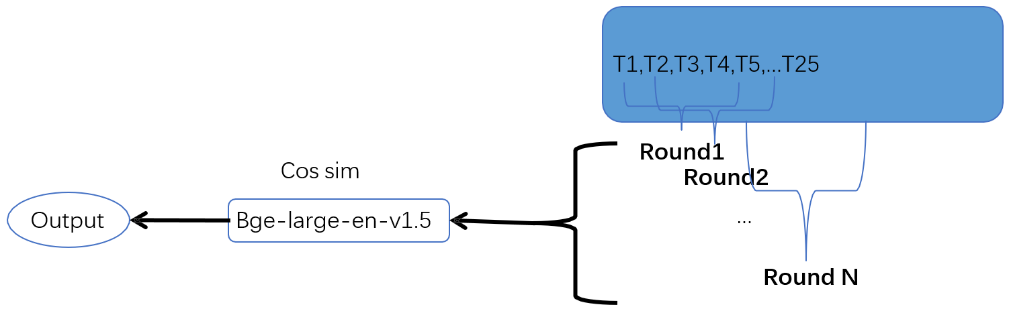
Similarity Matching
Utilizing Bge-large-en-v1.5 for Sentence Embedding

Slide 17
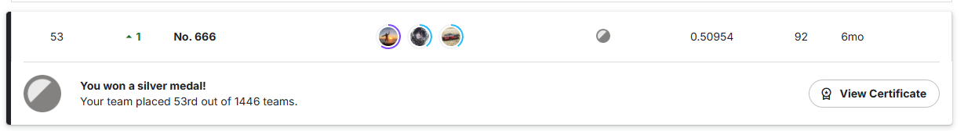
Results
Top 5% globally
Retrieval & reranking is the key.

Slide 18

Let’s chat & text

